Slide 1


Financial Highlights
As of April 30, 2025

Slide 2

Highlights of Interim Financial Report (unaudited)
April 30, 2025

Slide 3




Posted on Our Website
Finance / Monthly Finance Reports (hcde-texas.org)
Linked from State Comptroller’s website
http://www.texastransparency.org/local/schools.php
3

Slide 4
Top 12 Highlights points for April 2025
9. Ed Foundation at $335K in Equity
10. 10% small business-April ‘25
11. 99% Irvington Project
12. Phase I Projects – just pending retainage release and closeout
13. Budget Process underway
14. Budget amendments for approval due to revenues not being realized
$294K in tax revenue this month
Next Debt Svc payment in August
TOT Revenues at 64% Target of 67%
TOT Expenditures at 58% Target of 67%
$51M in Equity(F Bal) as of April 2025
$9,379 March Donations
Values at $660B out of $665B Projected
Choice at $6.9M Benefit Variance
Outlook Trend : Finance - Tax Revenues being received – Projected to utilize fund balance for operations given unrealized revenues
Revenues and exp. Below target
Operations - Normal Operations and On Target
Policy - Stable
Legislative - On going
4

Slide 5
Budget Calendar
May 30, 2025 - Budget Submission
June 24, 2025 - Board Workshop
July 16, 2025 - Board Workshop & Budget Adoption
Aug 25, 2025 - Tax Values to be received
Sept 17, 2025 - Tax Rate adoption tentatively (if no
additional public hearings are required
Outlook Trend : Finance - Grant awards pending
5

Slide 6

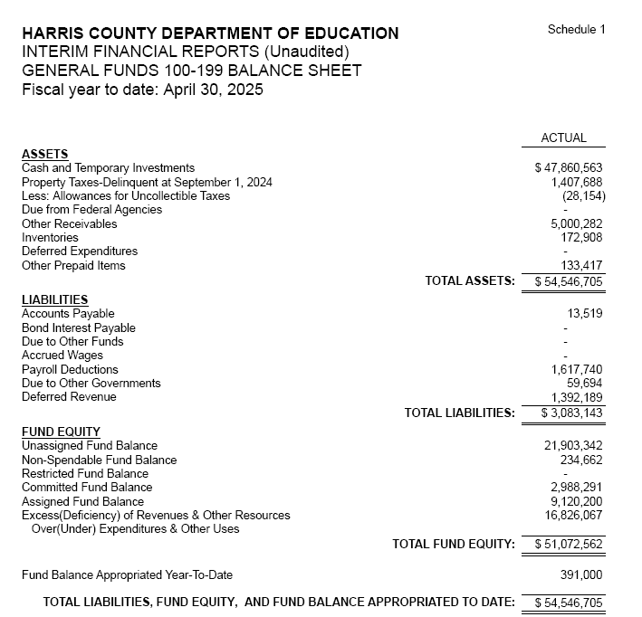
INTERIM FINANCIAL REPORT
(unaudited)
GENERAL FUND
Balance Sheet as of April 30, 2025
Total Assets:
$ 54,546,705
Total Liabilities:
$ 3,083,143
Total Fund Equity:
$ 51,072,562

Slide 7
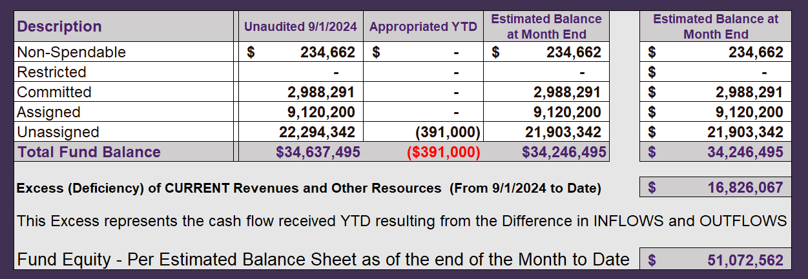
INTERIM FINANCIAL REPORT (unaudited)
ASST. SUPERINTENDENT FOR BUSINESS SERVICES MESSAGE
As of April 30, 2025
The ESTIMATED General Fund balance at 04/30/2025 is $52,746,816 after current appropriations.
As year end adjustments are completed, a budget amendment will be submitted to the board for items assigned, restricted and committed that will roll forward into FY 2025.
7

Slide 8
INTERIM FINANCIAL REPORT (unaudited)
As of April 30, 2025
Financial Ratios
Level One - Indicator of Financial Strength
Level Two - Indicator of Efficient Leverage
Level Three - Indicators of Efficiency
Level Four - Indicators of Revenue Growth

Slide 9
INTERIM FINANCIAL REPORT (unaudited)
As of April 30, 2025
Indicators of Financial Strength
Percent of Fund Balance to G/F
Expenditures Ratio
What is the percent of rainy-day fund balance?
(*) Unadjusted
Working Capital Ratio
What is the cash flow availability for the organization?
Unassigned Fund Balance $ 21,903,342
Total G/F Expenditures $ 43,126,443
Goal : > 30% of G/F Exp.
Benchmark: 10% to 29%
Danger: Under 10%
Goal : >$15,000,000
Benchmark : $10M to $15M
Danger : Under < $10M
Total Current Assets
Less Total Current Liabilities
$54,546,705-$3,083,143 =$51,463,562
50% FY25
40% FY24
$51M FY25
$45M FY24
Budgeted 29%
Details on Schedule 3
Budgeted $33M
Details on Schedule 1

Slide 10
INTERIM FINANCIAL REPORT (unaudited)
As of April 30, 2025
Indicators of Efficient Leverage Reserves
Unassigned Fund Balance Ratio
How much is available in reserves?
Debt to Income Ratio
What is the ability of HCDE to cover
its debt payments?
Unassigned Fund Balance $21,903,342
Total Fund Balance $51,463,562
Annual Principal and Interest Payments on
Term Debt and Capital Leases : $2,598,038
G/F Revenue Less Facility $59,952,510-4,587,774
Charges :
Goal: <75%
Benchmark: 50% to 75%
Danger: <50%
Goal: <25% of annual revenue
Benchmark: 25% to <49%
Danger: Over > 50%
43% FY25
37% FY24
4.69% FY25
4% FY24
Budgeted 65%
Details on Schedule 1
Budgeted 5%
Details on Schedule 5

Slide 11
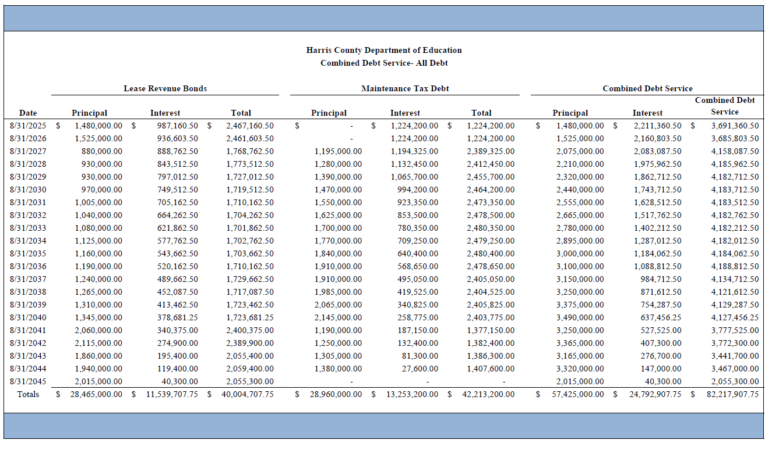




Combined Debt

Slide 12
INTERIM FINANCIAL REPORT (unaudited)
As of April 30, 2025
Indicators of Efficiency
Tax Revenue to Total Revenue Ratio
How efficient is HCDE at leveraging local
taxes? (Current)
Indirect Cost to Tax Ratio
How much dependency on indirect cost from grants?
Current Tax Revenue $30,627,726
Indirect Cost General Fund $1,397,067
Total Revenue $ 94,455,903
Total General Fund Revenues $59,952,510
Total General Fund Revenues $1,306,381
Goal: <20% of revenue
Benchmark: 20% to 30%
Danger: Over >30%
Goal: >5%
Benchmark: 2% to 5%
Danger: Under < 2%
Goal: >5%
Benchmark: 2% to 5%
Danger: Under < 2%
32% FY25
27% FY24
2.3% FY25
2.2% FY24
Budgeted 22%
Details on Schedule 2
Budgeted 3.6%
Details on Schedule 3

Slide 13
INTERIM FINANCIAL REPORT (unaudited)
As of April 30, 2025
Indicators of Revenue Growth
Fee for Service Revenue Ratio
How are revenues spread across all Funds?
Fee for Service Revenue Growth Ratio
What is the market growth for fee on services?
Total Fee for Service Revenues (G/F) $19,299,893
Total Revenues $94,455,903
Fee for Service Current Year Less Fee for Services Last Year $19,299,893-21,251,616
Fees for Service Last Year $21,251,616
Goal: >30% of annual revenue Benchmark: 10% to 29%
Danger: Under 10%
Goal: >3% of + growth
Benchmark: 0% to 3%
Danger: Under 0%
20% FY25
19% FY24
-9% FY25
26% FY24 ​
Budgeted 39%
Details on Schedule 14
Budgeted 17%
Details on Schedule 14

Slide 14
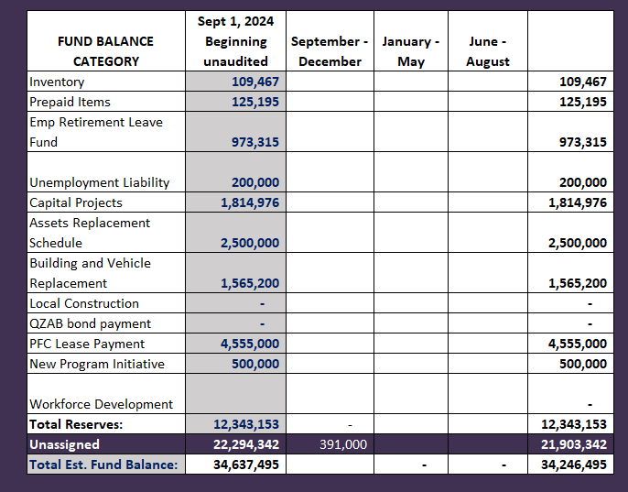
FY 2024-2025
Fund Balance
-
Budgeted Activity
Previous Budget Amendments:
Leadership Academy in Crosby $350,000
Prairie view Grant match $ 41,000

Slide 15
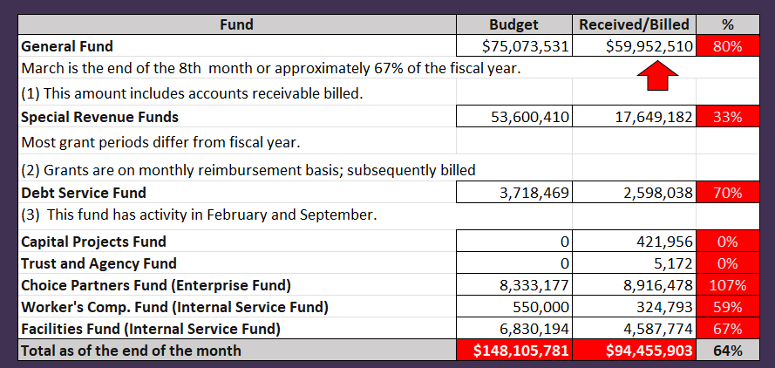
INTERIM FINANCIAL REPORT (unaudited)
GENERAL, SPECIAL REVENUE, DEBT SERVICE FUNDS, CAPITAL PROJECTS,
AND INTERNAL SERVICE FUNDS
REVENUES (INFLOWS)
Budget to Actual for period ending April 30, 2025

Slide 16
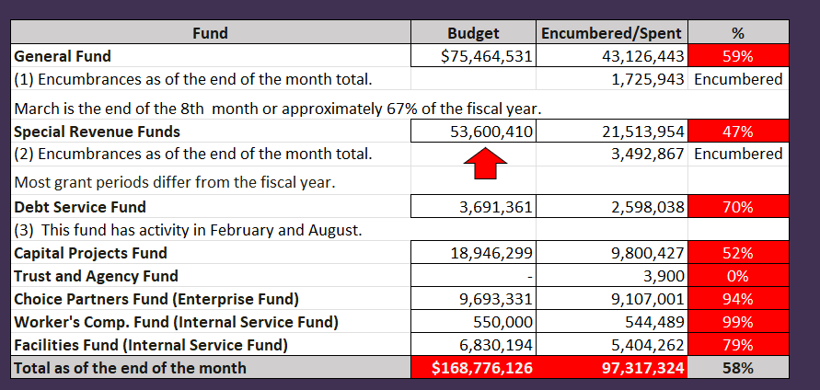
INTERIM FINANCIAL REPORT (unaudited)
GENERAL, SPECIAL REVENUE, DEBT SERVICE FUNDS, CAPITAL PROJECTS,
AND INTERNAL SERVICE FUNDS
Expenditures (OUTFLOWS)
Budget to Actual for period ending April 30, 2025

Slide 17
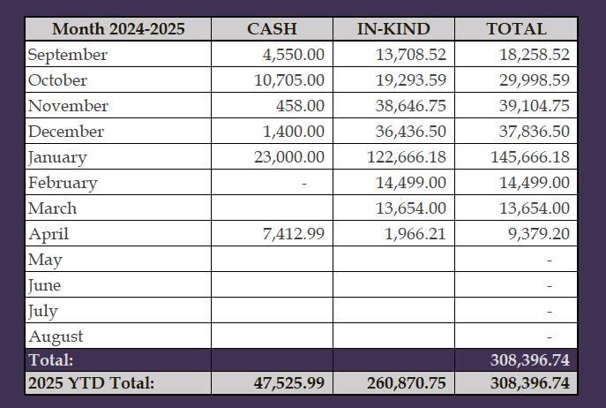
INTERIM FINANCIAL REPORT (unaudited)
FY 2024-25 Donations Report
All Funds as of April 30, 2025

Slide 18
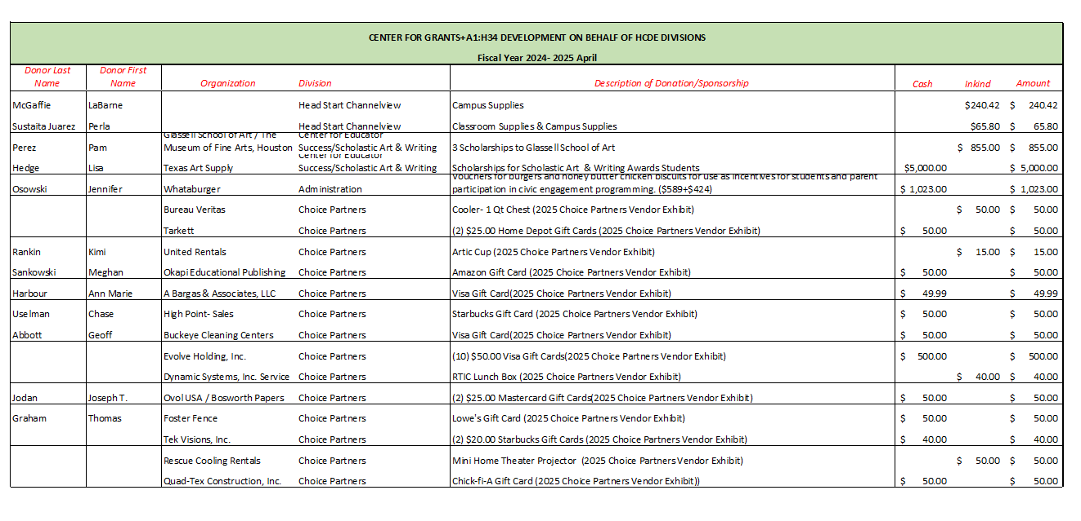
INTERIM FINANCIAL REPORT (unaudited)
FY 2024-25 Donations Report
All Funds as of April 30, 2025

Slide 19
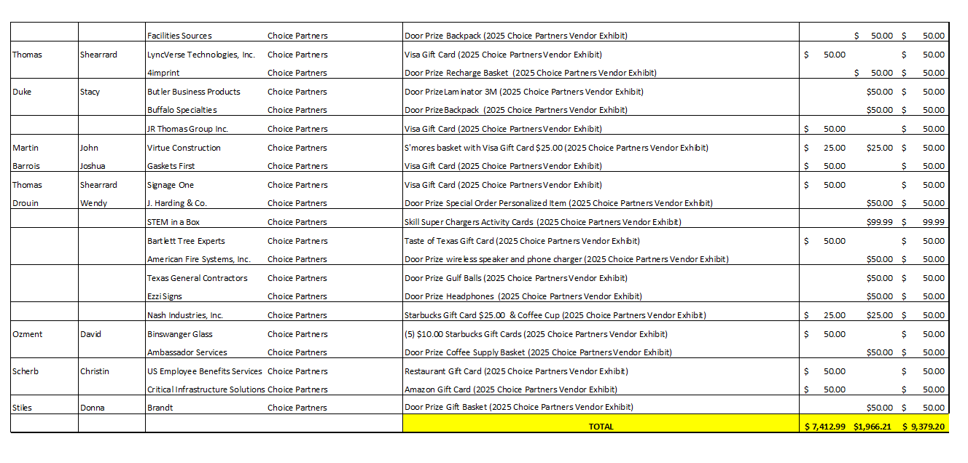
INTERIM FINANCIAL REPORT (unaudited)
FY 2024-25 Donations Report
All Funds as of April 30, 2025

Slide 20
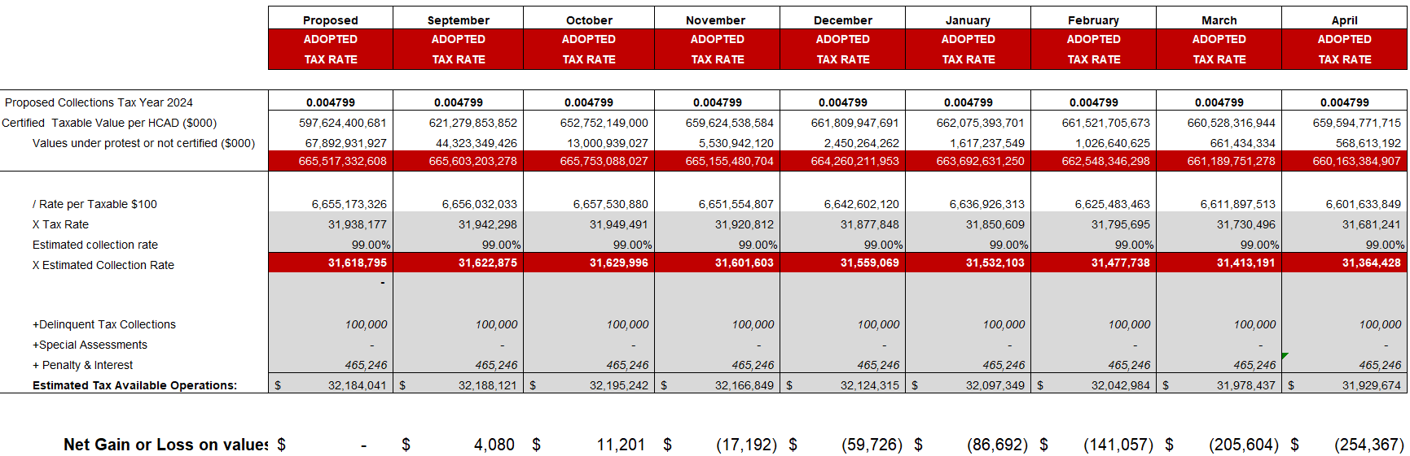
INTERIM FINANCIAL REPORT (unaudited)
TAX COLLECTIONS COMPARATIVE ANALYSIS
Fiscal Year-To-Date as of April 30, 2025
$660 B
See Tax Calculator at:
https://hcde-texas.org/transparency/tax-rate/

Slide 21
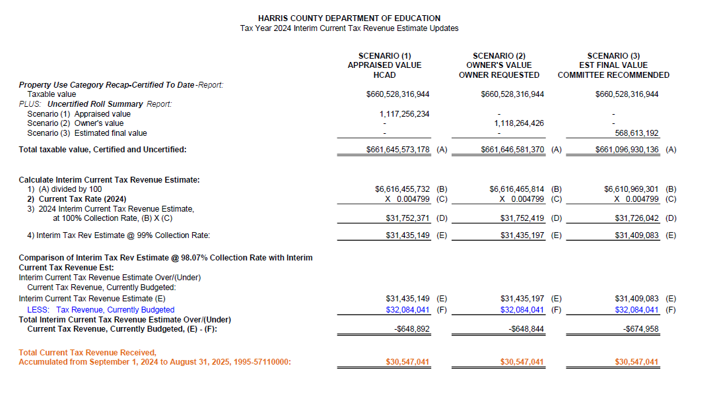
INTERIM FINANCIAL REPORT (unaudited) TAX COLLECTIONS
Fiscal Year-To-Date as of April 30, 2025
(8th month / 12 months)

Slide 22
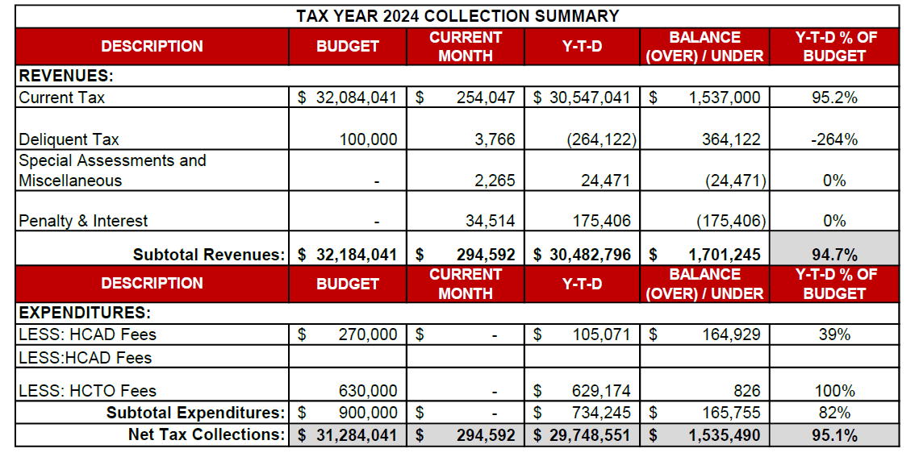
INTERIM FINANCIAL REPORT (unaudited) TAX COLLECTIONS
Fiscal Year-To-Date as of April 30, 2025
(8th month / 12 months)
a) 2024 Approved Tax Rate = $0.004799/$100 Property Assessment/Appraisal - --> Annual Tax on a $259,375 - $51,875 = $207,500/100
x .004799 = $9.958 (net of 20% homestead exception.)
b) $850,000/$32,184,041 = 2.64% Collection and assessment costs

Slide 23
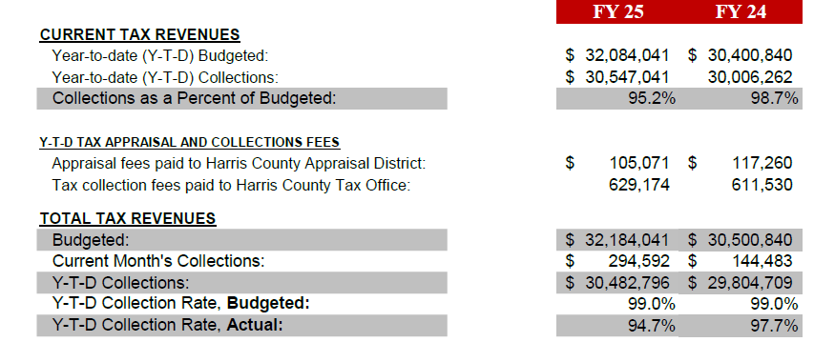
INTERIM FINANCIAL REPORT (unaudited) TAX COLLECTIONS
Fiscal Year-To-Date as of April 30, 2025
(8th month / 12 months)
a) 2024 Approved Tax Rate = $0.004799/$100 Property Assessment/Appraisal - --> Annual Tax on a $259,375 - $51,875 = $207,500/100
x .004799 = $9.958 (net of 20% homestead exception.)
b) $850,000/$32,184,041 = 2.64% Collection and assessment costs

Slide 24
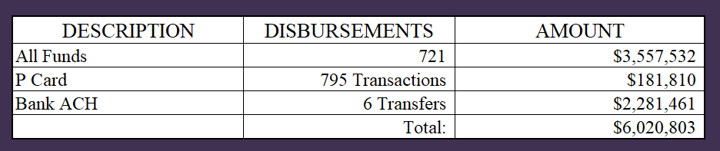
INTERIM FINANCIAL REPORT (unaudited)
DISBURSEMENT – ALL FUNDS
April 30, 2025
Notes:
All Purchase Orders and Payment Authorizations are reviewed before disbursement.
All Procurement Card charges are reviewed by cardholder, supervisor, and business office staff each month.
A report on CH Local Expenditures is included in the monthly report.

Slide 25
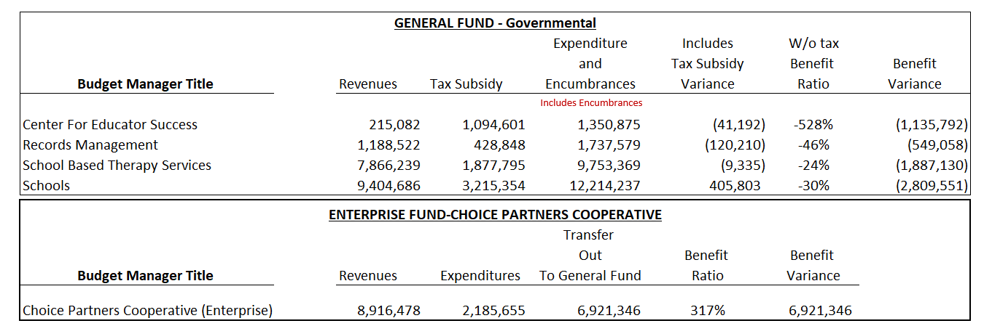
INTERIM FINANCIAL REPORT (unaudited)
Segment Division Data
As of April 30, 2025

Slide 26
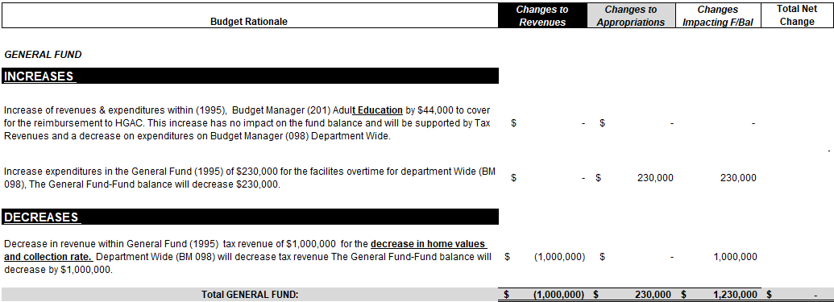
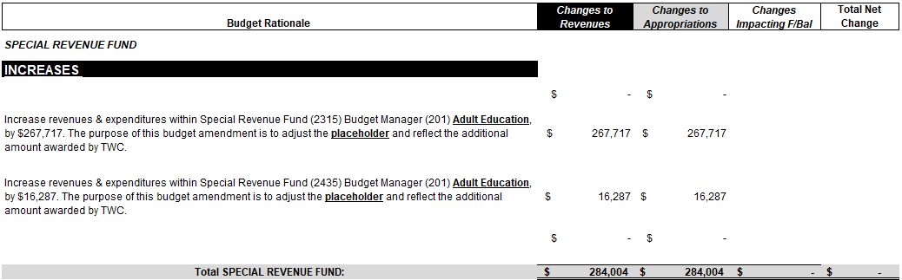
HIGHLIGHTS OF BUDGET AMENDMENT REPORT
May 21st, Board Meeting
(unaudited)

Slide 27
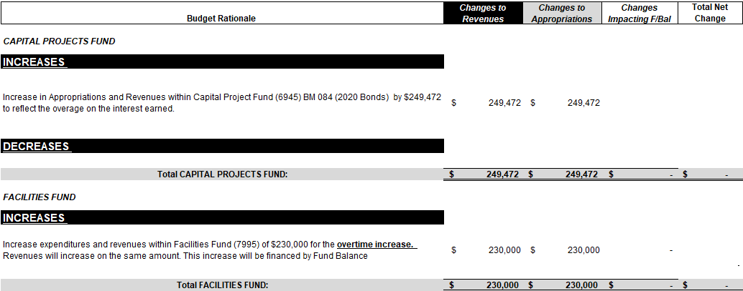
HIGHLIGHTS OF BUDGET AMENDMENT REPORT
May 21st, Board Meeting
(unaudited)

Slide 28

Education Foundation Update
April 30, 2025
28

Slide 29
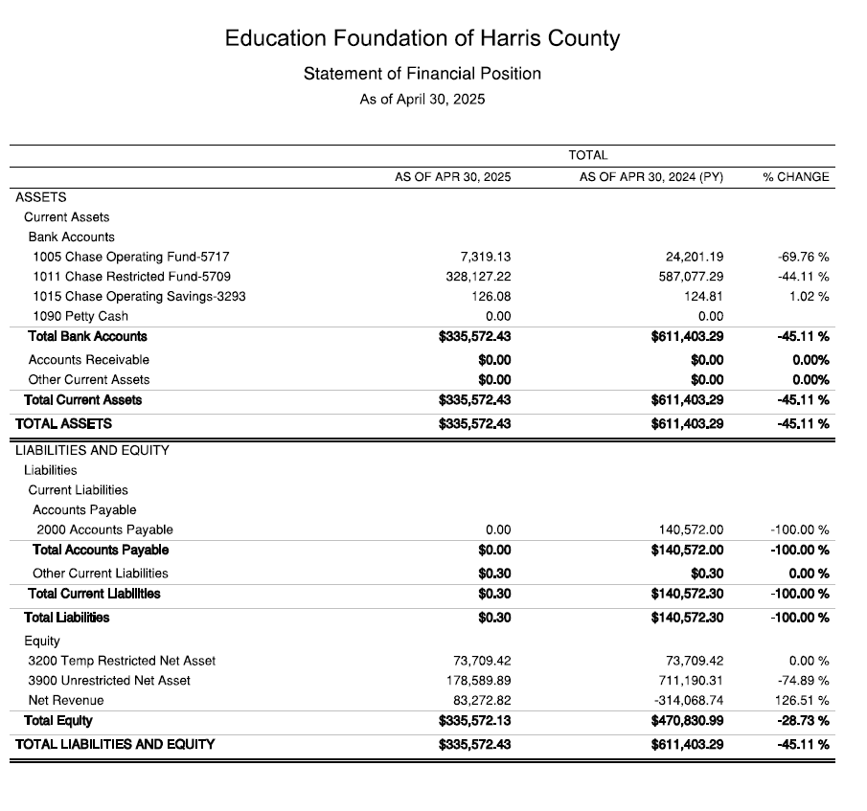
Statement of Financial Position
Net Equity
$335,572

Slide 30
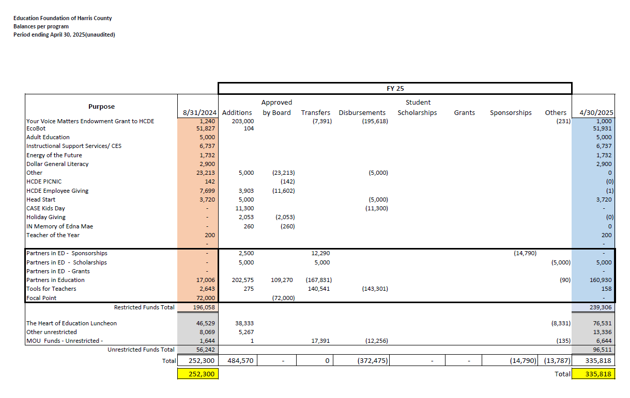
Ed Foundation Balances Per Program

Slide 31
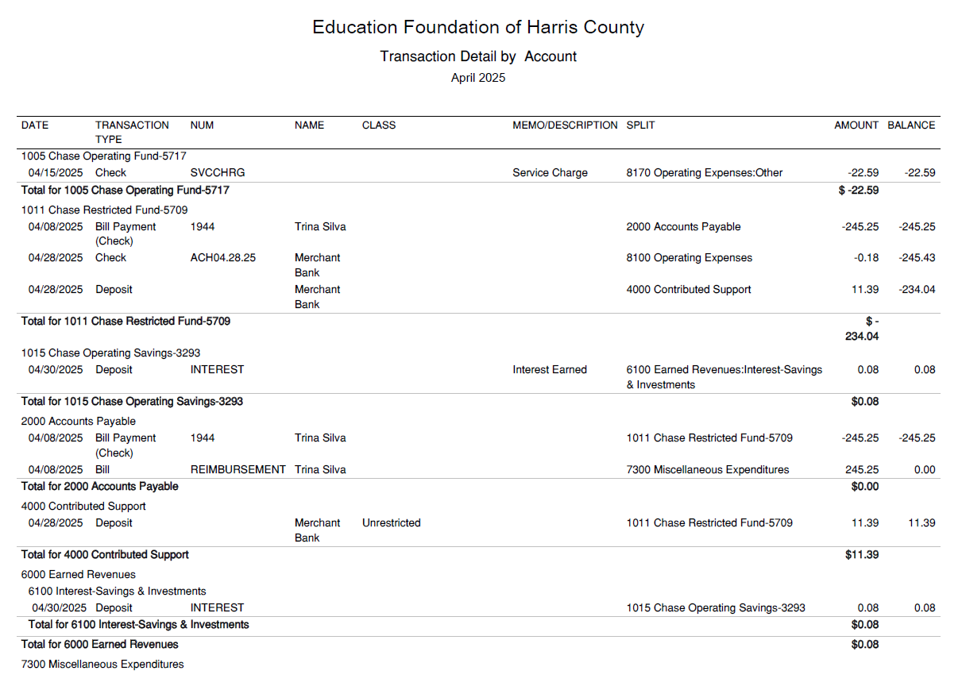
Transaction Detail by Inflow & Outflow

Slide 32
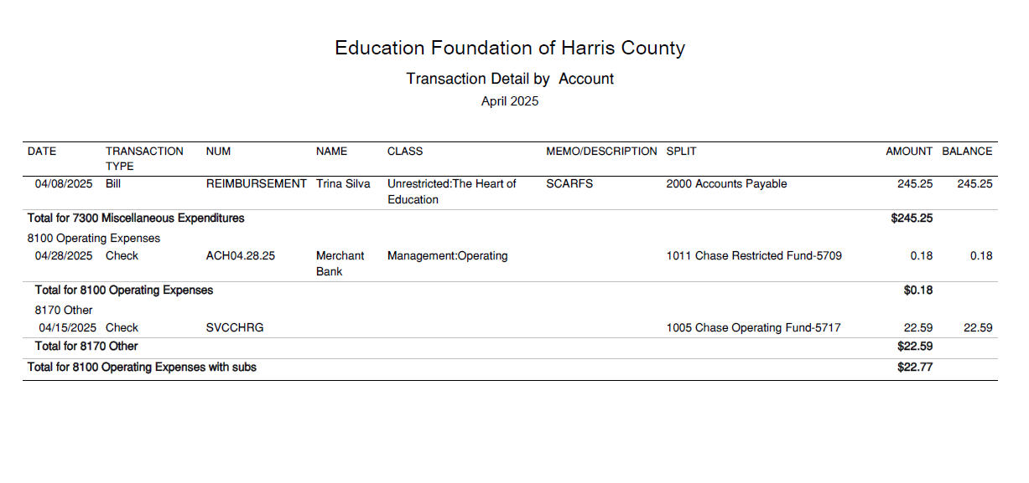
Transaction Detail by Inflow & Outflow

Slide 33

PFC & Lease Revenue Projects Update
April 30, 2025
33

Slide 34
Harris County Department of Education
Small Business Report
09/01/24 to 04/30/25
FY 2024-2025
By
Dr. Edna E. Johnson
Procurement Director

Slide 35
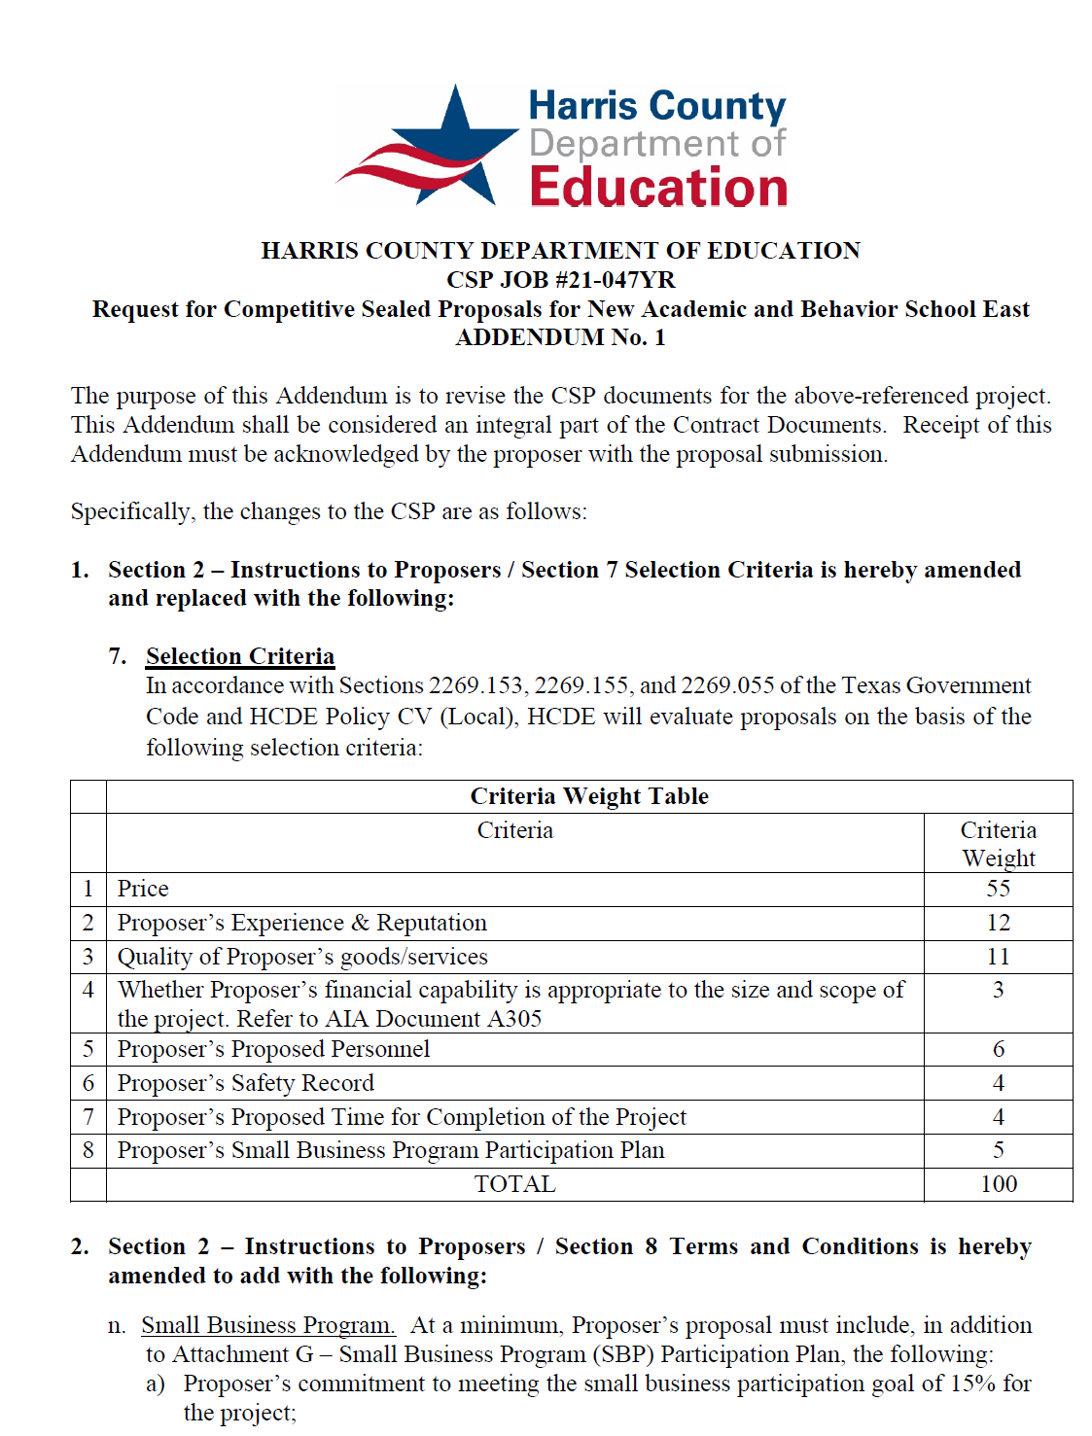
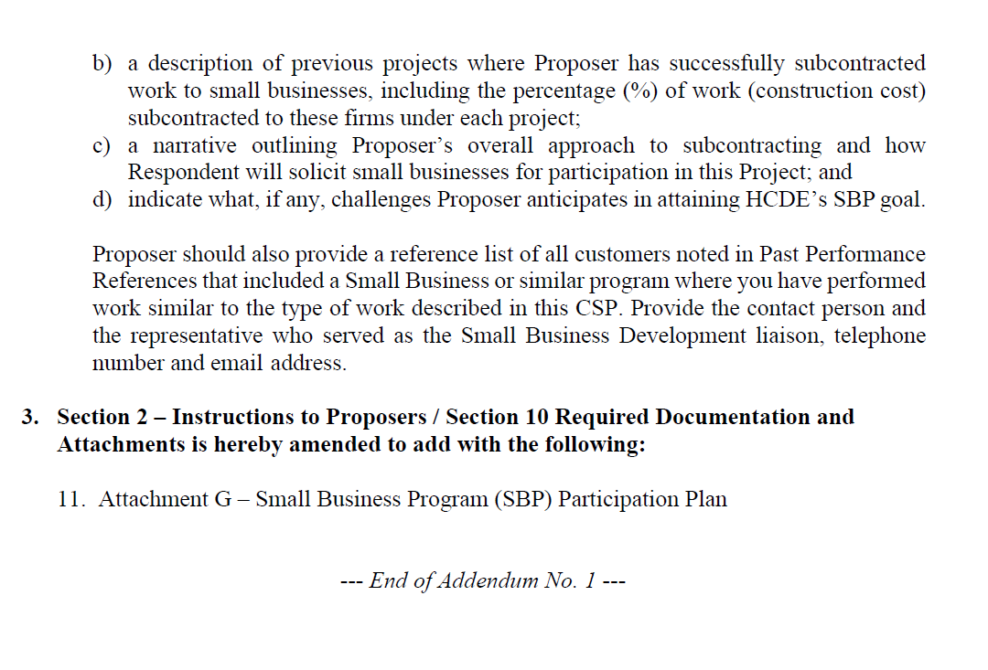
Small Business
for Construction
Launch industry's first collaboration feature
This is our plan as we launch the industry's first collaboration feature

Slide 36
Content
Definitions
Certifying Agencies
Small Business Expenditures for FY2025 Year to Date (09/01/24 to 04/30/25)
Graphics
List of Small Businesses
36

Slide 37
Definitions
HUB – Historically Underutilized Business is a business entity in which at least fifty-one percent ownership is by a woman, minority, and/or service-disabled veteran.
MBE – Minority Business Enterprise are fifty-one percent owned, operated and controlled by a minority group.
SBE – Small Business Enterprise are private corporations, partnerships, or sole proprietorships with 500 or fewer employees.
WBE – Woman Business Enterprise is fifty-one percent owned and controlled by one or more women who are U.S. citizens or Legal Resident Aliens.
37

Slide 38
Certifying Agencies
  City of Houston
  Houston Metropolitan Transit Authority
  Port of Houston
  South Central Texas Regional Certification Agency
38

Slide 39
09/01/24 to 04/30/25
Expenditures FY 24-25
Small Business $1,771,599
Non-Small Business $15,138,557
Total Business = $16,910,156
Govt and Utilities $3,374,160
Total Expenditures = $20,284,316
Small Business $1,771,599
divided by
Total Business $16,910,156
= 10% Ratio Small/Large
39

Slide 40
09/01/2024 – 04/30/2025
Small Business Amounts by Certifying Agency
Name of Agency
City of Houston $1,022,643
Houston Metropolitan Transit Authority $269,440
Port of Houston $479,516
Total $1,771,599
40

Slide 41
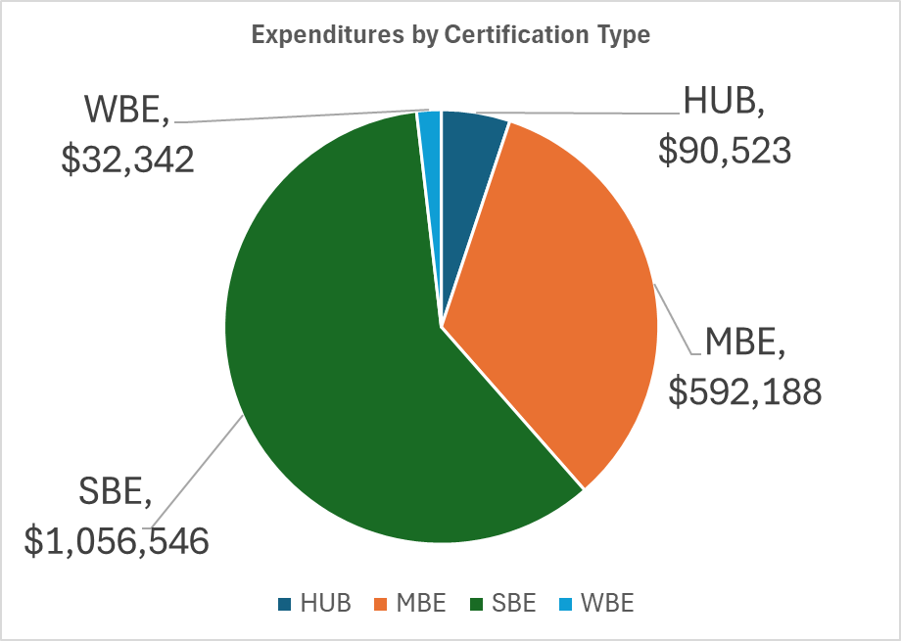
09/01/24 – 04/30/25
Small Business by Certification Type
Certification Type
SBE | $1,056,546
HUB | $90,523
MBE | $592,188
WBE | $32,342
 | $1,771,599
41

Slide 42
Small Business list for FY 2025
42
42

Slide 43
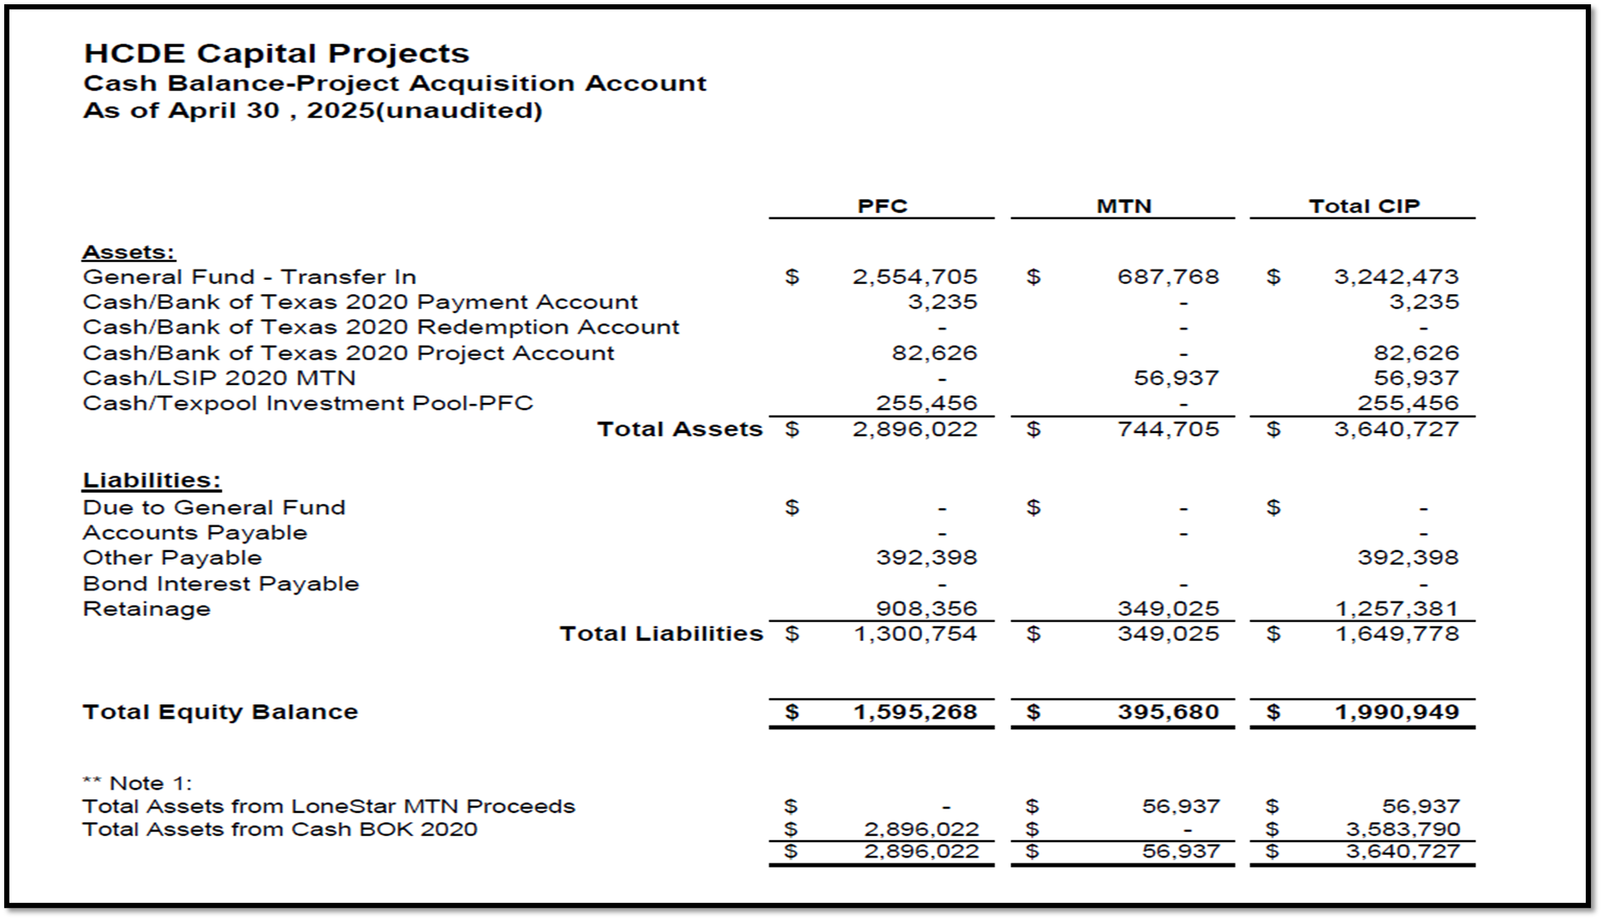

AB East School Contract $12,358,000 Awarded
Adult Ed Center Contract $15,121,000 Awarded on Oct 2021 Board Mtg
HP East Contract $7,271,000 Awarded on Nov 2021
Irvington – $11,172,589 Awarded on Jan 2024
Cash Balance –
Project Acquisition Account
As of April 30, 2025
43

Slide 44
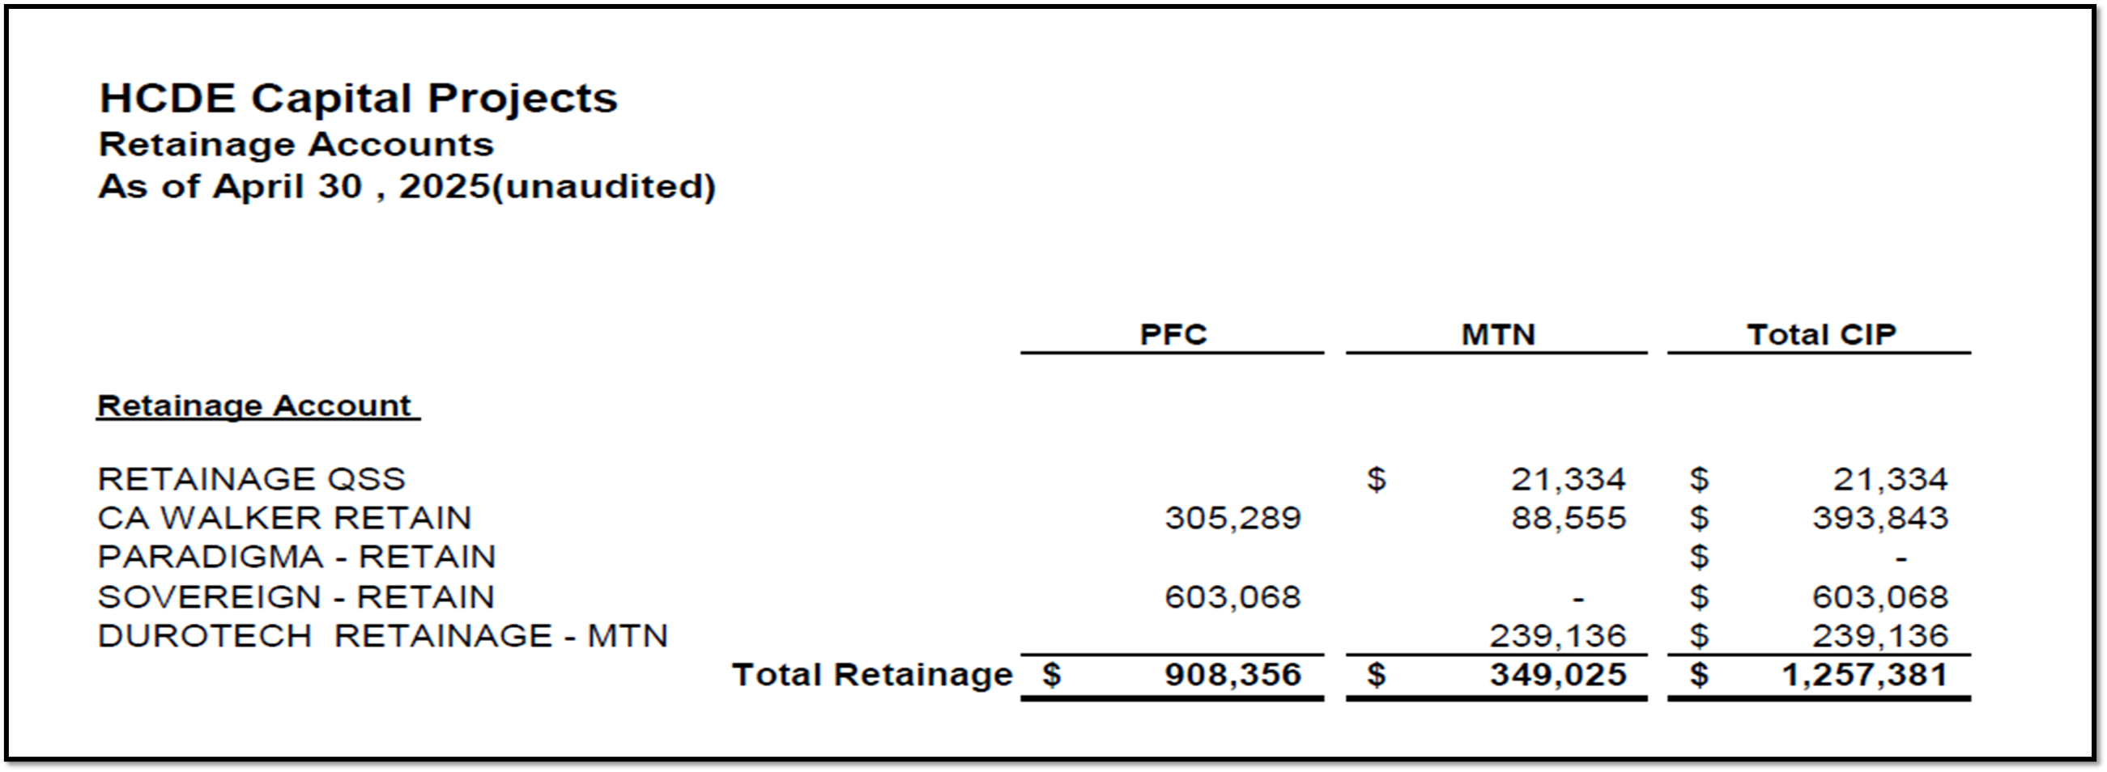
2020 MTN NOTES/2020 PFC BONDS
Pending Retainage Payable
Retainage Payable
Project Acquisition Account
As of April 30, 2025
44

Slide 45
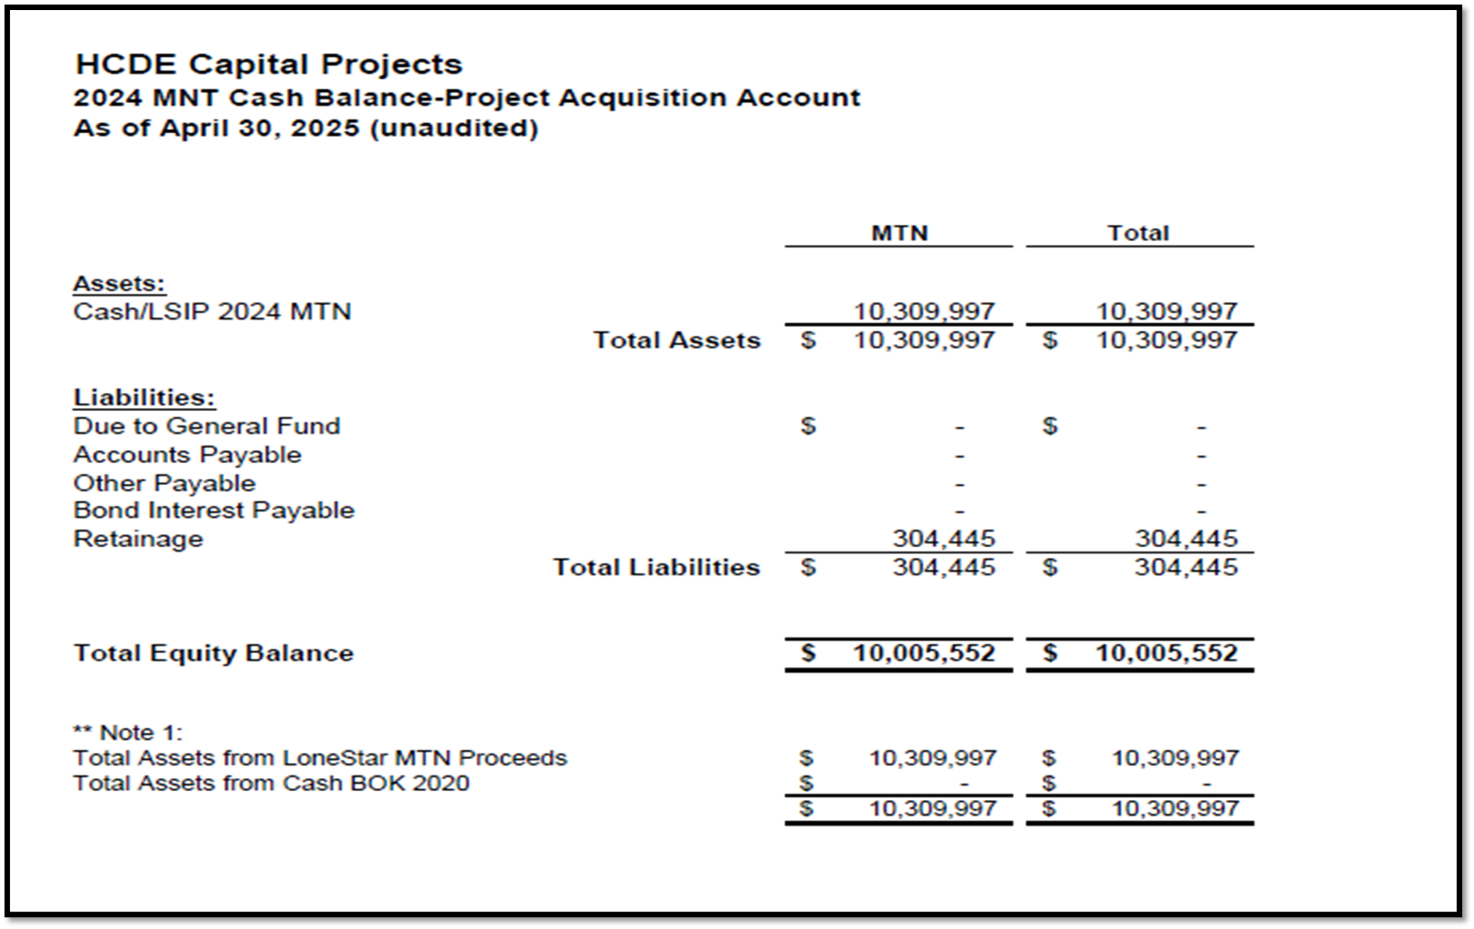
AB West $333,000 March 2024 Board Mtg
HS Barrett Station $470,000 March 2024 Board Mtg
Fortis Academy $650,000 March 2024 Board Mtg
Irvington – $9,860,000 March 2024 Board Mtg
Post Oak - $5,000,000 March 2024 Board Mtg
$16,313,000
Cash Balance –
2024 Maintenance Notes
As of April 30, 2025
45

Slide 46
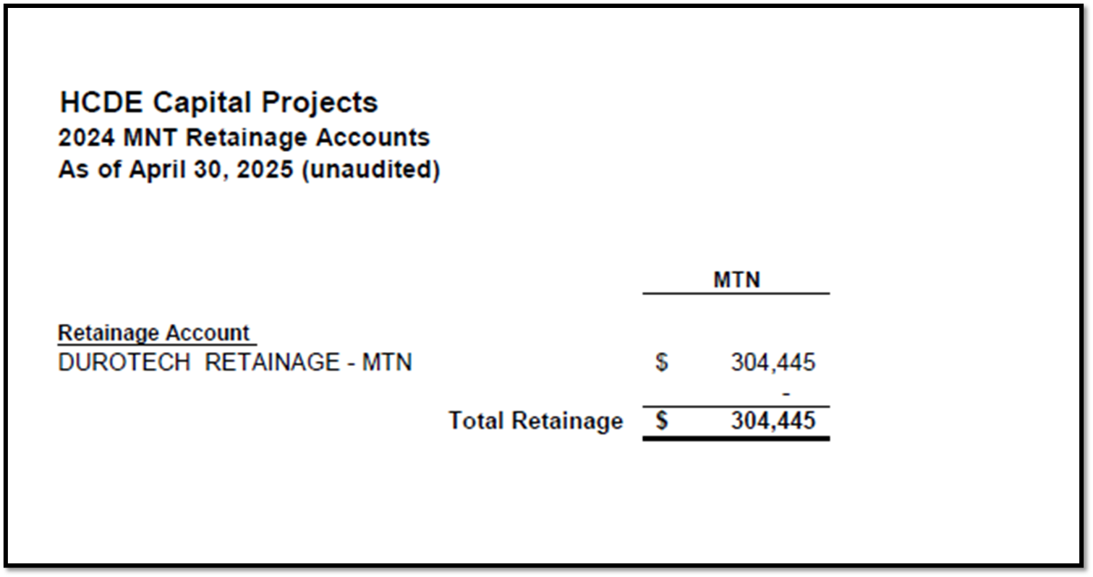
AB West $333,000 March 2024 Board Mtg
HS Barrett Station $470,000 March 2024 Board Mtg
Fortis Academy $650,000 March 2024 Board Mtg
Irvington – $9,860,000 March 2024 Board Mtg
Post Oak - $5,000,000 March 2024 Board Mtg
$16,313,000
Retainage Payable
2024 Maintenance Notes
As of April 30, 2025
46

Slide 47
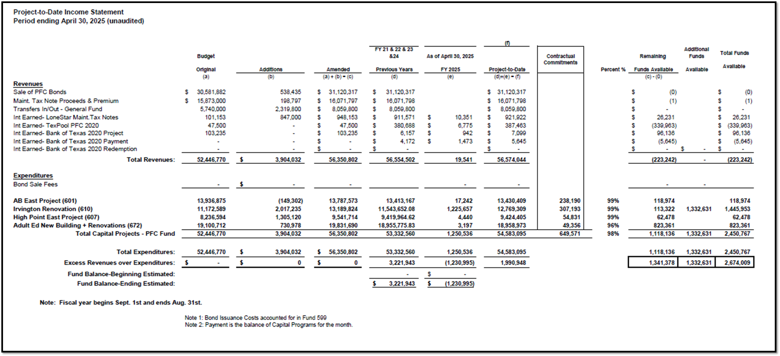
Income Statement– Project Acquisition Account
As of April 30, 2025
47

Slide 48
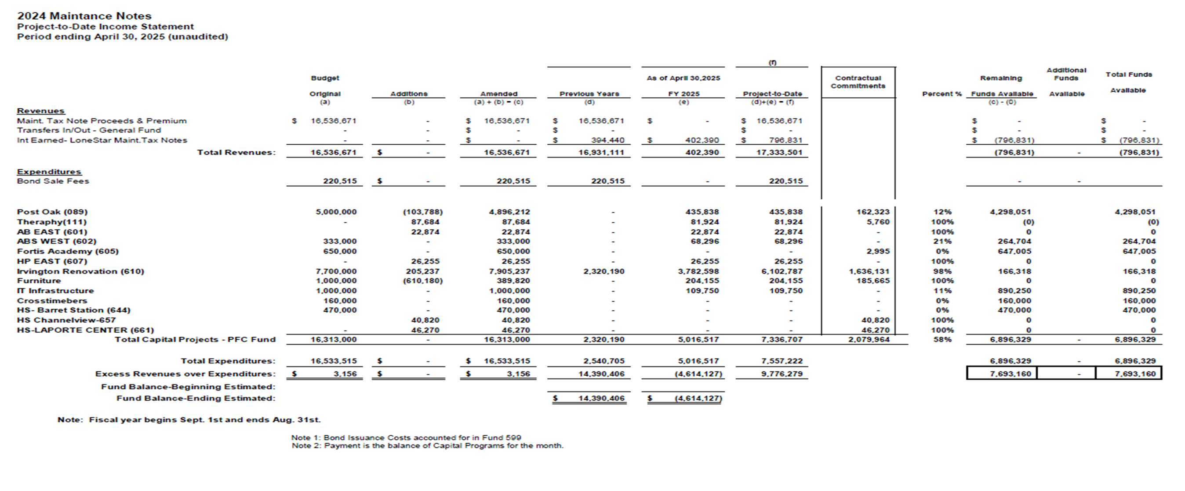
Income Statement– 2024 MNT NOTES
As of April 30, 2025
48

Slide 49
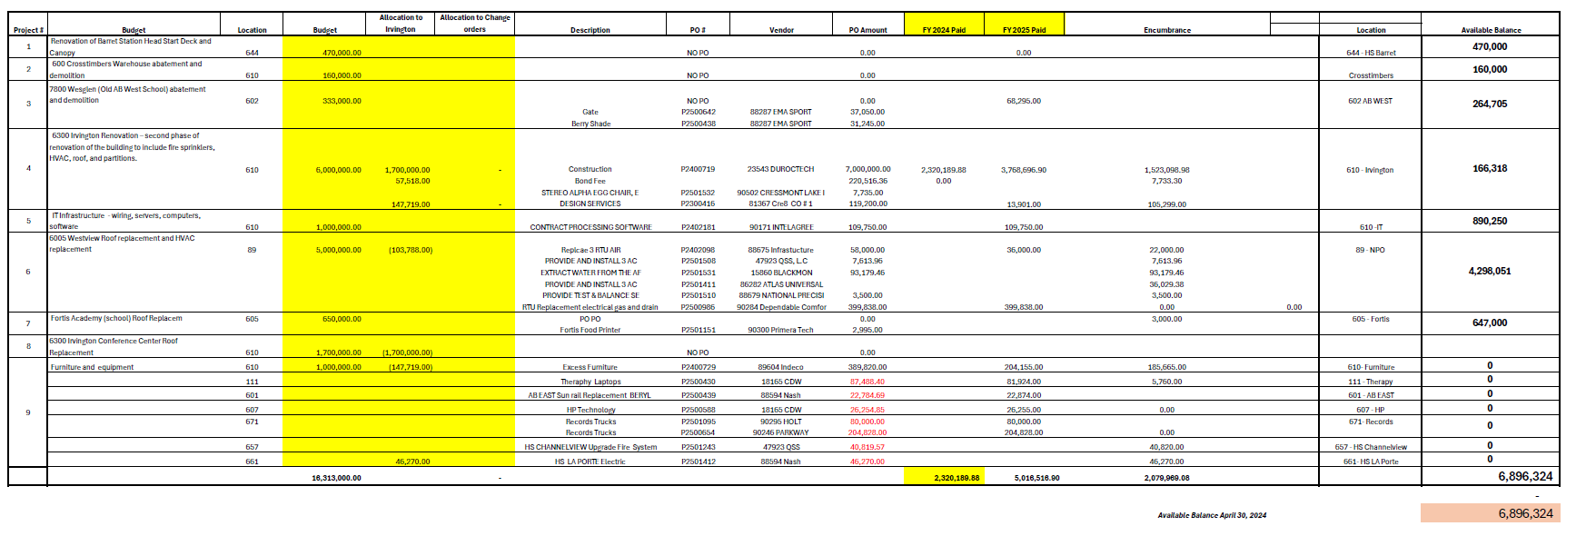
Maintenance Notes 2024 – Projects
49

Slide 50
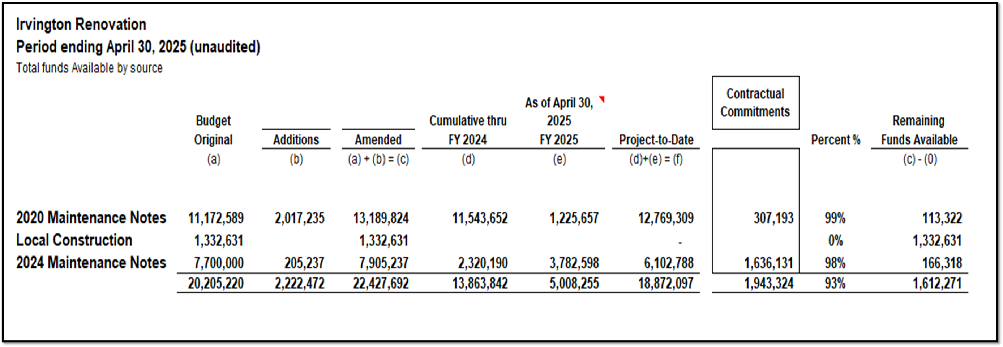
Irvington Renovation – Funds by Source
As of April 30, 2025
Irvington Renovation 2020 Maintenance Notes $ 4,781,519
Contract 2024 Maintenance Notes $ 7,000,000
Total $11,781,519
50

Slide 51

Interim Financial Report (unaudited)
I certify that the foregoing information is true and accurate to the best of my knowledge.
/s/ Jesus J. Amezcua, RTSBA,CPA, Ph.D., CPFIM, Asst. Supt. for Business Support Services
/s/ Marcia Leiva, Chief Accounting Officer

